Slide 1

The Machine Learning Process
Python 101 – Object and Data Structures Basics
Sathish Ravichandran

Slide 2

Rules for variable names
Cannot Start with number
Cannot contain Space
studentage = 5 X
student_age=5 ✔
Cannot use symbols
;’”,<>/?\|()!@#$%^&*`~
Best Practice – use lower case

Slide 3
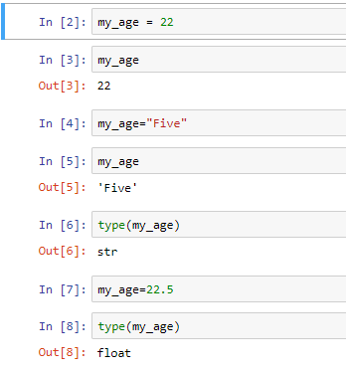
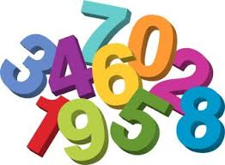
Dynamic Typing
Reassign same variables to different data types

Slide 4
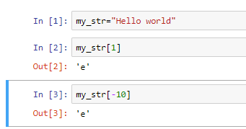
String
Character: h e l l o w o r l d
index : 0 1 2 3 4 5 6 7 8 9 10
Reverse index: 0 -10 -9 -8 -7 -6 -5 -4 -3 -2 -1

Slide 5
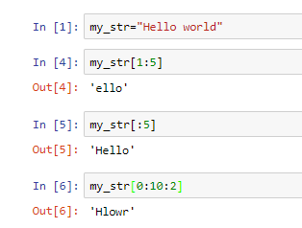

Slicing with String
Syntax: String_name[start:stop:step]

Slide 6
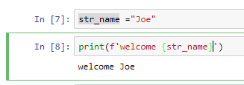
Print format String
Pass the variable name into Print
Notes:
str_name=“Joe”
print(f'welcome {str_name}')

Slide 7
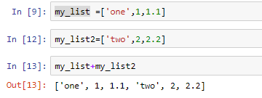

Lists
Lists can hold variety of object types
Contains lots of useful functions
Explore the following functions in List
append()
pop()
sort()
reverse()

Slide 8


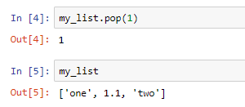
Lists – append() and pop()
append()
pop()
Notes:
my_list=['one',1,1.1]
my_list.append('two’)
my_list.pop(1)

Slide 9

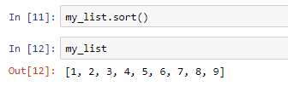
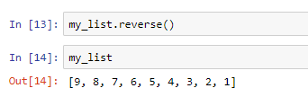
Lists – sort() and reverse()
sort()
reverse()
Notes:
my_list=[9,8,7,6,5,4,3,2,1]
my_list.sort()
my_list.reverse()

Slide 10

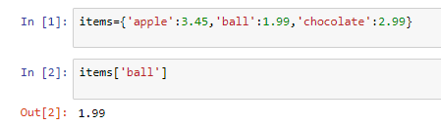
Dictionaries
Uses Key value pair to store objects
No need to know the index location
Cannot be sorted
Syntax: {‘key1’ : ‘value’ , ‘key2’ : ‘value’}
Use case – Prices lookup
Notes:
items={'apple':3.45,'ball':1.99,"chocolate":2.99}
items['ball']

Slide 11
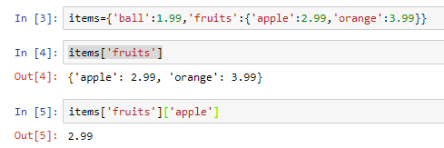

Nested Dictionaries
We can place dictionaries inside another dictionaries
Notes:
items={'ball':1.99,'fruits':{'apple':2.99,'orange':3.99}}
items['fruits’]
items['fruits']['apple']

Slide 12

Dictionaries
d={'k1':1,'k2':2,'k3’:3}
Try the following functions
d.keys()
d.values()
d.items()
Notes:
d={'k1':1,'k2':2,'k3’:3}
d.keys()
d.values()
d.items()

Slide 13



More on Dictionaries
d.keys()
Returns all the keys
d.values()
Returns all the values
d.items()
Returns all the items in the dictionaries

Slide 14
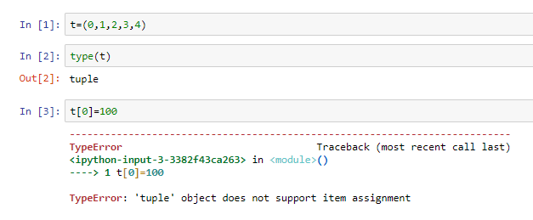
Tuples
Similar to Lists, but Tuples are immutable
Once elements are inside tuple, they cannot be reassigned
Notes:
t=(0,1,2,3,4)
t[0]=100

Slide 15
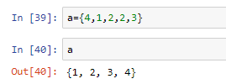

Sets
Sets are Unordered collections of unique elements
But it is ordered right?
Lets Discuss…

Slide 16
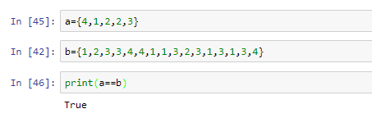

Sets
The order does not matter here…
Notes:
a={4,1,2,2,3}
b={1,2,3,3,4,4,1,1,3,2,3,1,3,1,3,4}
print(a==b)

Slide 17
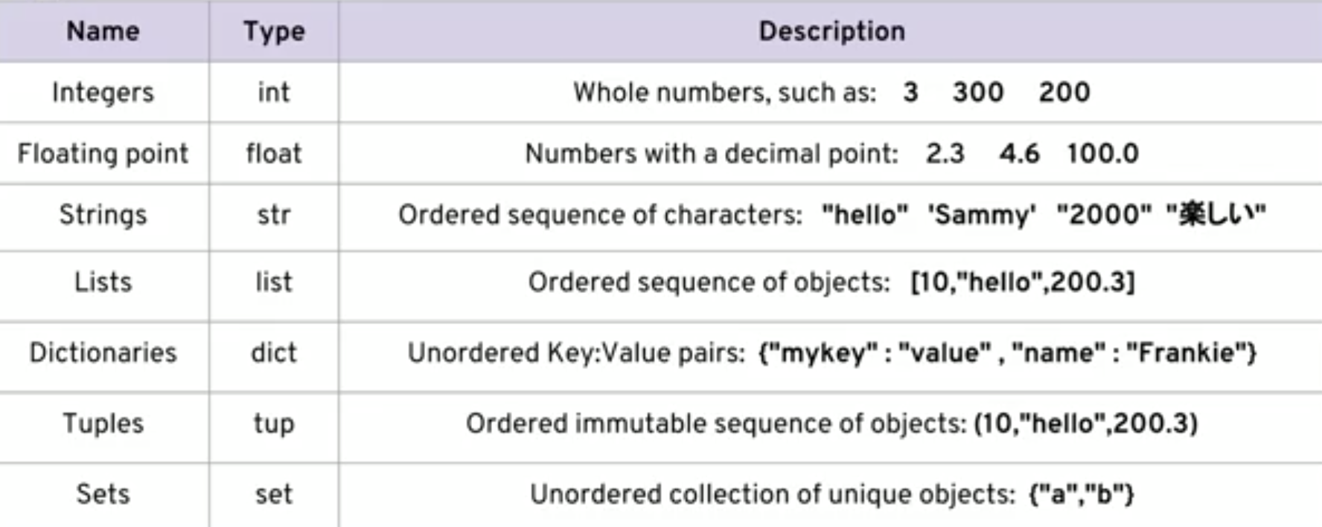
To Summarize

Slide 18
Thank you
The Capacity to learn is a gift;
The ability to learn is a skill;
The willingness to learn is a choice.
-Brian Herbert

